Slide 1
Secure Software Development
Eli Rolfes
Elsheika Thompson
RET is funded by the National
Science Foundation,
grant # EEC-1710826.

Slide 2
Eli Rolfes
Algebra 2 Teacher
Holmes High School
Covington, KY

Slide 3
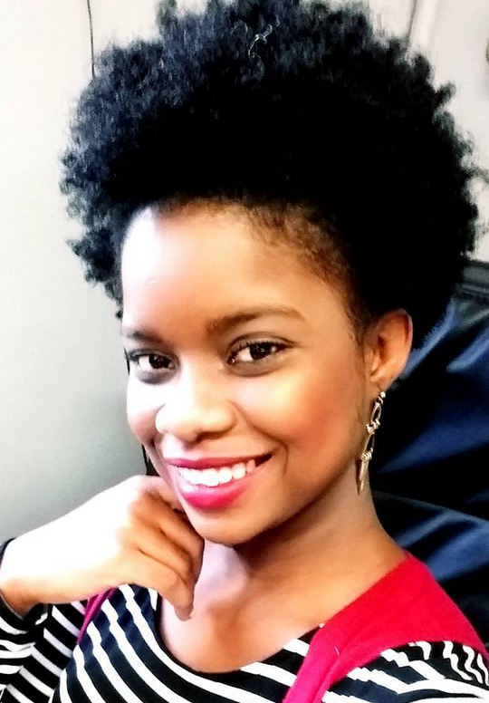
Elsheika Thompson
Algebra 1 Teacher
Beechwood High School
Fort Mitchell, KY

Slide 4
Attack On Ebay
Notes:
Hook: Ebay suffered this attack in kjhkjkj and about 50 million users’ information was compromised.

Slide 5
Here’s what to look forward to:
Abstract
Introduction
Research Details (Goals and Weekly Objectives)
Research Progress
Classroom Implementation
Background Literature Review- overview

Slide 6
Abstract
Cross Site Scripting (XSS) compromises the security and usability expected from web applications.
A solution for detecting XSS opens the door to explore solutions for detecting other types of attacks.
This study employs human intuition to develop an algorithm for finding vulnerabilities in web applications.

Slide 7
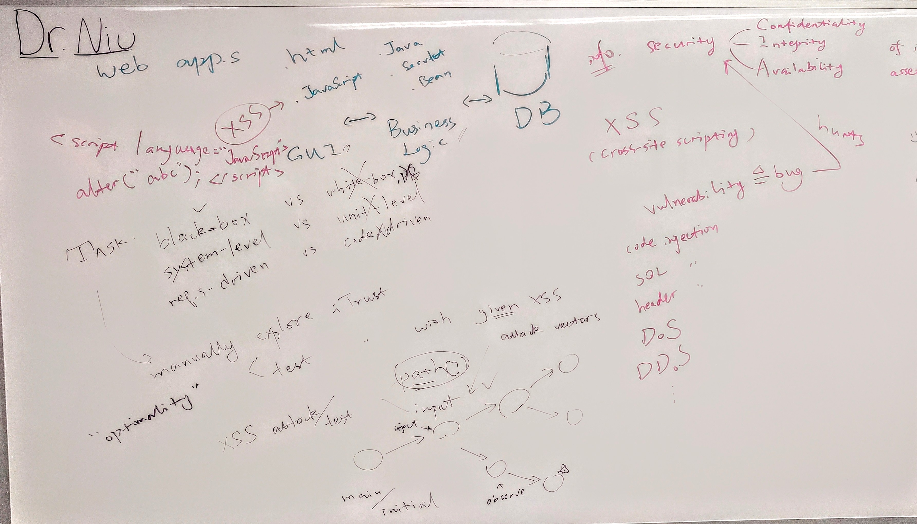
Research Lab Notes

Slide 8
Web App Limitations
Confidentiality
Integrity
Availability
Notes:
There are limitations to designing web applications. These are known as the “CIA Triad”
We want our data to be safe, we want to trust it, and we want to be able to access it. This is where vulnerabilities come in
2FA (2 factor authentication) used for secure websites is irritating, but it keeps you safe.

Slide 9
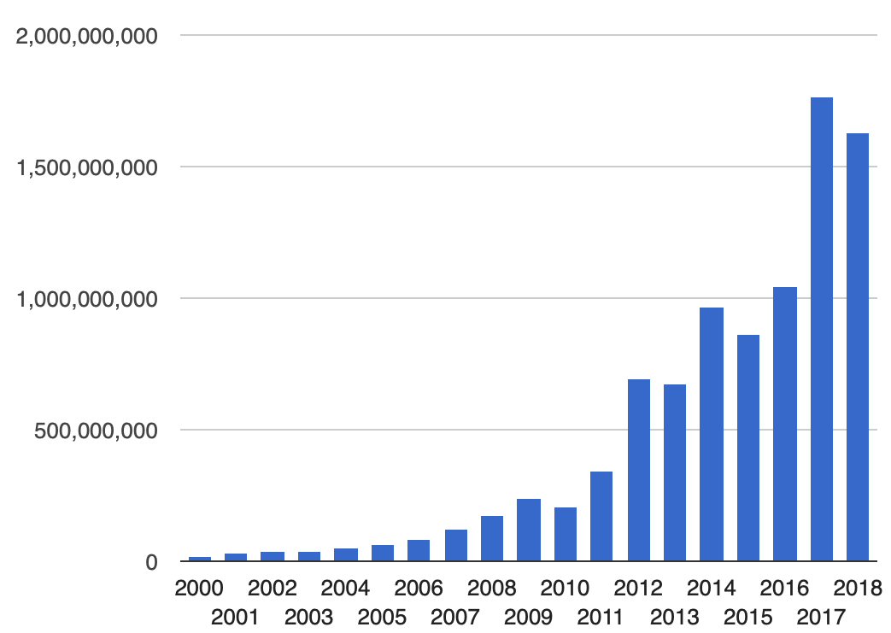
What is Cross-Site Scripting (XSS)?
Type of computer security vulnerability
Allows attackers to inject client-side scripts into web pages viewed by other users.
*XSS accounted for 84% of all security vulnerabilities in 2007
There are more than 7.2 MILLION vulnerable sites!
4.4% of websites have ≥ 1 XSS vulnerability
*http://eval.symantec.com/mktginfo/enterprise/white_papers/b-whitepaper_exec_summary_internet_security_threat_report_xiii_04-2008.en-us.pdf

Slide 10
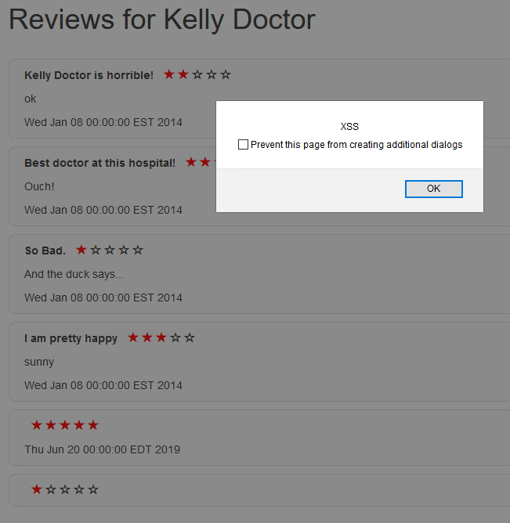
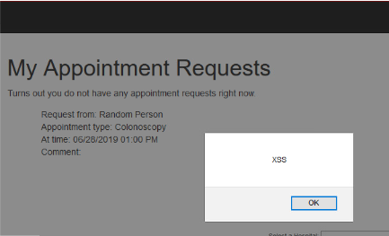
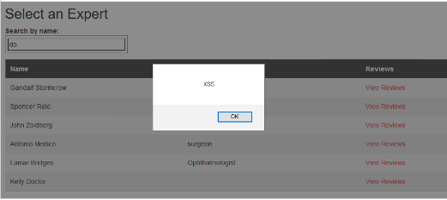
Notes:
If we enter a tiny string of code in the right place, we can make this text boxes pop up on the screen.
Transition: The reason we could do this is because we used a sandbox web app called iTrust.
ethics

Slide 11
iTrust
Notes:
iTrust is a “sandbox” tool for engineers to experiment. It runs on a local server, so if we break things we can fix it.
---
We can login as patients, HCPs, Admins, Lab techs, etc to try out all the features of the website.
Transition: There are specific features of interest that we wanted to explore.

Slide 12
Xss Attack On iTrust

Slide 13
Computers are much faster than humans, but not as smart.
Notes:
Transition: If we go back to the first example we shared, we can provide a clearer explanation.

Slide 14
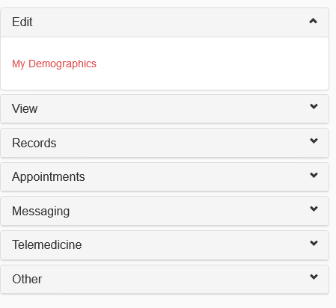
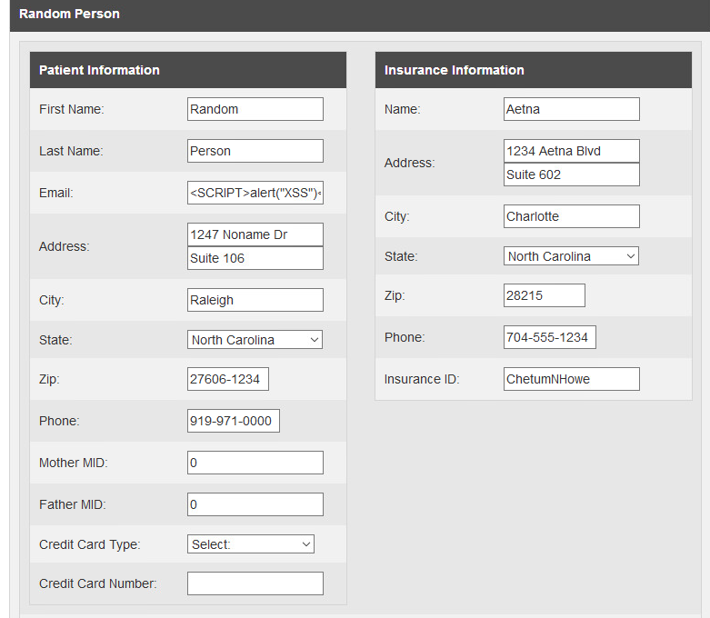
Notes:
If you’re logged in as a patient, you can edit information about yourself. Each of these text boxes is a place where the malicious code could potentially be entered.
If we try every text box, we get errors for some. (click to show last name error)
You can see a space where code has already been entered.

Slide 15
Notes:
We can see that when Kelly Doctor looks up a list of patients, she see the error. It pauses the loading of the website and pops up a dialog box. You can see that Random Person doesn’t have an email.
This is a harmless example
This process is tedious and takes a considerable amount of time. (It took me half an hour)
Transition: We want to use machines to do it faster, and that involves challenges of its own

Slide 16
“Request an Appointment” Process
Request an Appointment
Where does this information display?
View Appointment Requests
Notes:
This middle section is where human intuition is a major factor. We understand where to look better than a computer does.

Slide 17
Using human intuition, develop an algorithm for finding web application vulnerabilities
Goal
Notes:
Research Goals

Slide 18
‘Message’ Pathway
Compose Message
Subject
Message
Subject
Message
Messaging
Message Inbox
Read
Reply
Message Outbox
Notes:
This is a more complex example of a decision pathway. There are multiple different routes for us to consider.
We put more weight into the ideas that we think are smart. We are more likely to be able to inject code at “compose message” than at “message outbox”, so we want to check there first.

Slide 19
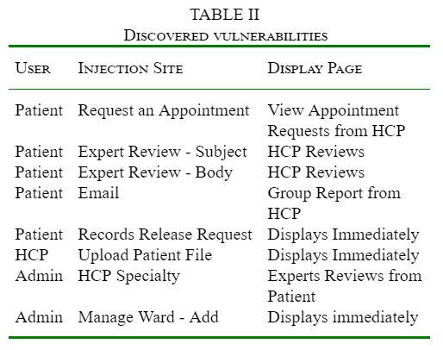
Operational Insights
1. Vulnerabilities can be revealed by injecting attack at one function and checking the related functions.
2. Vulnerabilities can be revealed by checking communication channels between different users/roles.

Slide 20
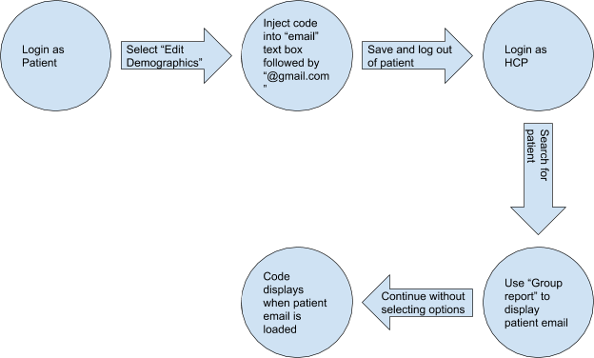
Example Pathway

Slide 21
Objectives
Week 2
Week 3
Week 4
Familiarize ourselves with the ITRUST
Independently derive a rationale for injecting XSS vector vulnerabilities in ITRUST
Merge rationales
Create a single algorithm
Team PowerPoint
Coding an algorithm that can detect vulnerabilities on iTrust
Research Paper Draft

Slide 22
Objectives
Week 5
Week 6
Week 7
Coding an algorithm that can detect vulnerabilities on iTrust
Refine Research Paper
Finalize deliverables
Future research will be to generalize and apply the algorithm to other web applications.
NSF Summary Report

Slide 23
Classroom Plan Eli Rolfes
Topic: Comparing Functions
Essential Questions:
How do we respond to the zombie outbreak?
How can we use our understandings of functions to survive the zombie outbreak?
How does technology help us solve epidemiological problems?
Challenge: Plot and justify a course of action to cure the zombie outbreak.
Notes:
Connection to public health

Slide 24
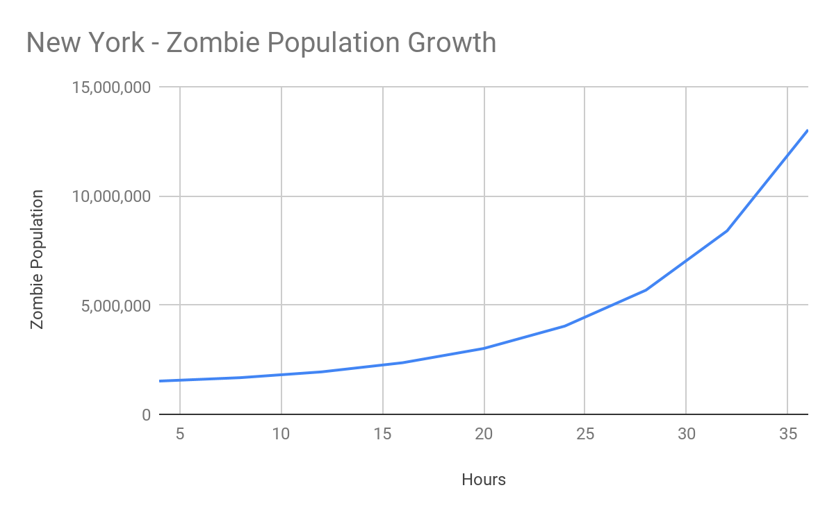
Activity One Guided Questions Discovery
Students will begin to analyze the data set to discover the functions involved

Slide 25
Activity Two Career Research
Students will conduct research into careers in public health

Slide 26
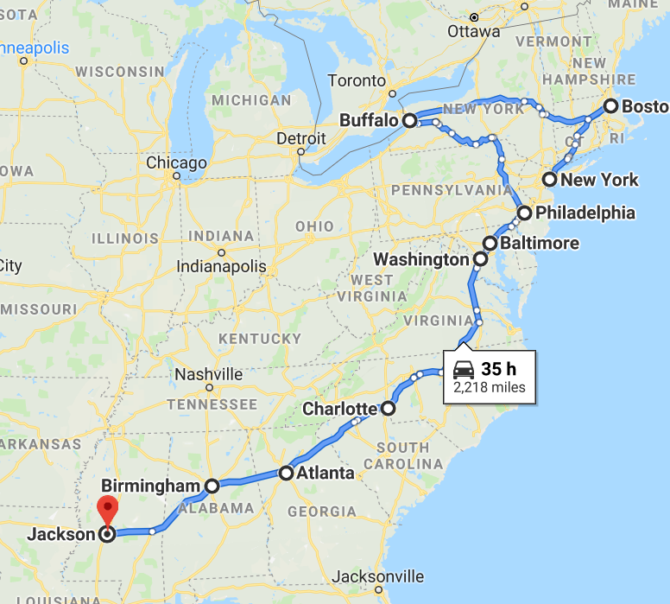
Activity Three Plotting the cure
Students will chart a path for curing the zombie outbreak based on functions

Slide 27
Activity Four Presentations
Teams will present and justify their solutions to the zombie outbreak

Slide 28
Classroom Plan Elsheika Thompson
The Hook

Slide 29
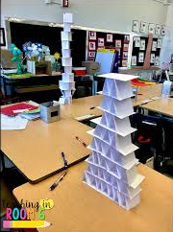
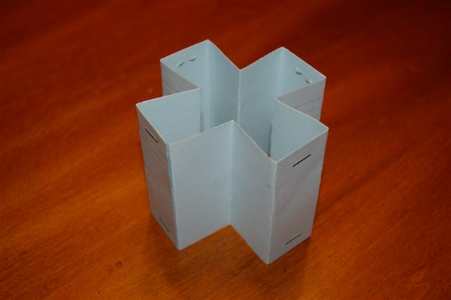
Activity One Introduction to the Engineering Design Process
Identify parts of the Engineering Design Process
Apply the Engineering Design Process through designing and building a model tower.

Slide 30
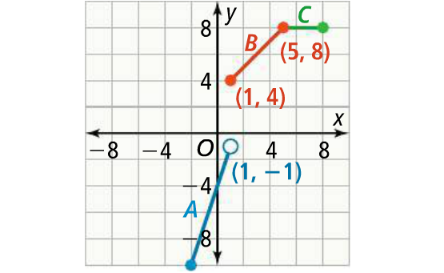
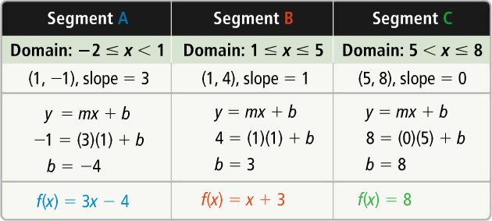
Activity Two Foldable Pieces and Pieces to Continue
Graph linear piecewise-defined function
Write a linear piecewise-defined function
Notes:
Students will also differentiate between continuous and discrete graphs.

Slide 31
Activity Three Exploring Bridges
Identify types of bridges
Compare and contrast the different types of bridges
Identify careers associated with bridge designing and building.
Understand the importance of bridges in communities.
Understand the societal impacts of bridge closures.

Slide 32
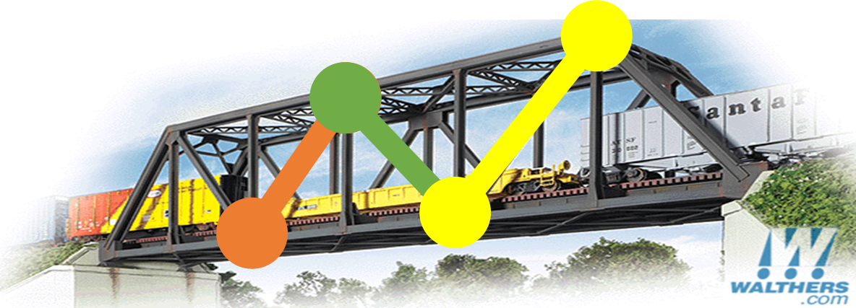
Activity Four The Challenge
The Ministry of Public Works’ Proposal
Essential Questions:
What is the connection between truss bridges and linear functions?
What features of a truss bridge makes it safe?
What materials can we use to model a truss bridge?
Challenge: To build a model secure truss bridge.

Slide 33
References
Godefroid, P., Klarlund, N., and Sen, K. (2005). DART: Directed automated random testing. ACM SIGPLAN Notices, 40(6), 213-223.
Godefroid, P., Levin, M.Y., and Molnar, D.A., Automated Whitebox Fuzz Testing, in Proc. the 10th Network and Distributed System Security Symposium, San Diego, CA, USA, February, 2008
Kallepalli, C., and Tian, J. (2001). Measuring and modeling usage and reliability for statistical web testing. IEEE Transactions on Software Engineering, 27(11), 1023-1036.

Slide 34
Special Thanks
Dr. Nan Niu
Wentao Wang
Dr. Boyang Wang
Lora Buchanan
Dr. Margaret Kupferle
Pamela Truesdell
The National Science Foundation (NSF)
University of Cincinnati

Slide 35
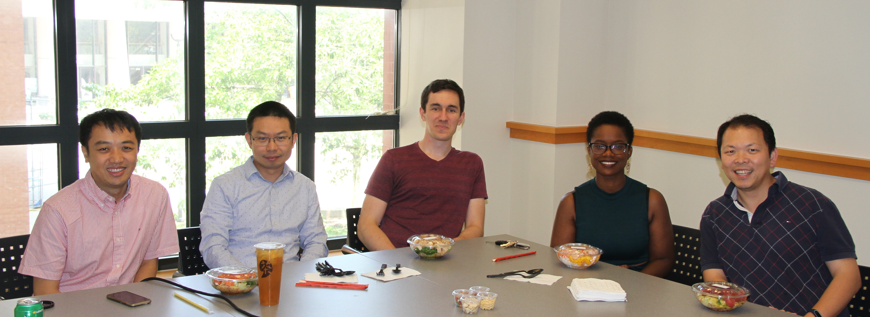
Research Team

